Slide 1



Final Year Project Presentation
DevOps CloudSandbox
Interactive Learning Platform for Enterprise DevOps Infrastructure Simulation
Presented By:
Oshunyingbo Adedeji | July 22, 2026

Slide 2


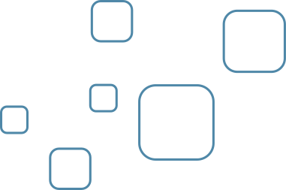
Project Purpose
• Simulate enterprise DevOps infrastructure locally without costly cloud resources
• Teach cloud-native skills through hands-on container and Kubernetes practice
• Provide a safe environment for students and developers to experiment freely
• Enable practical learning of container orchestration and infrastructure concepts
Why This Project Exists

Slide 3



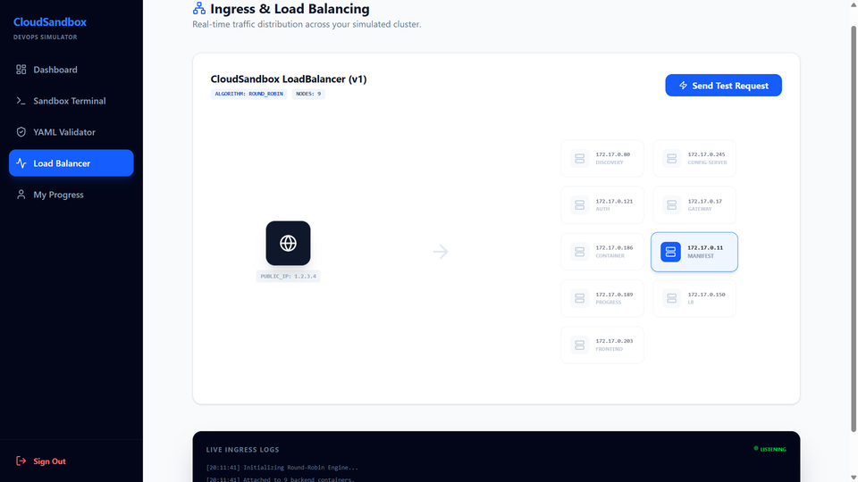
Core Platform Capabilities
Key Feature Overview
Container Management Simulation
Kubernetes Manifest Validation
Load Balancer Simulation
Progress Tracking & Gamification
Interactive Terminal Experience
User Management

Slide 4
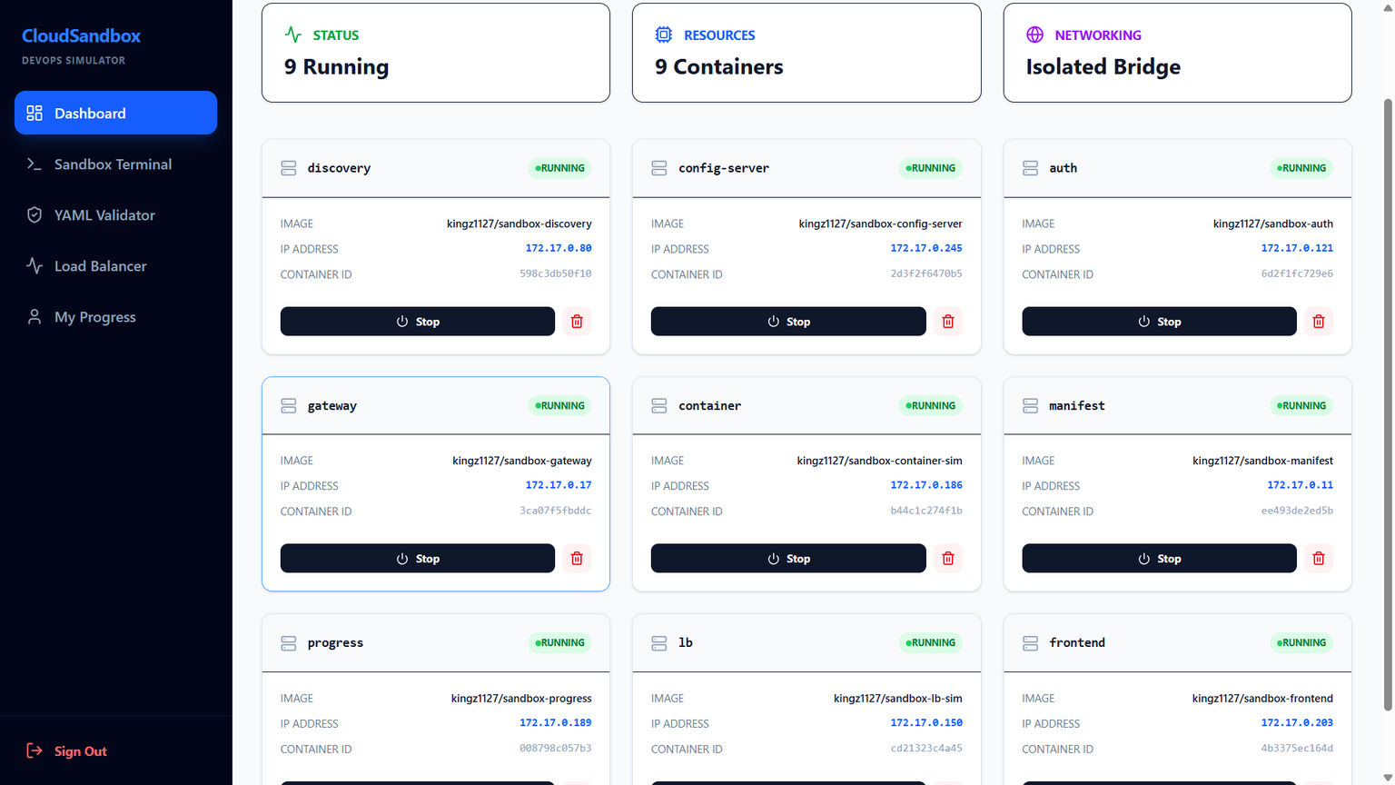
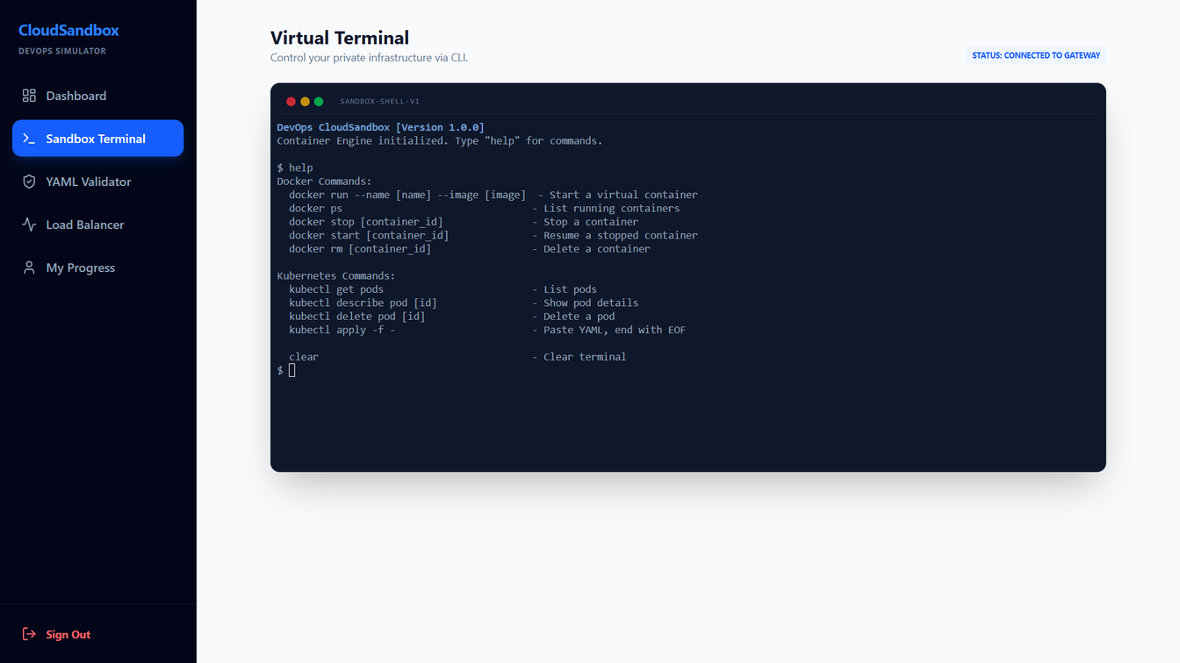

Container Management Simulation
Docker-like Commands & Real-Time Monitoring
Run, stop, start, and delete containers with Docker-like CLI commands. Each container receives a simulated IP address and unique container ID. Monitor real-time status (RUNNING / STOPPED) and validate Docker Hub images before pulling.

Slide 5
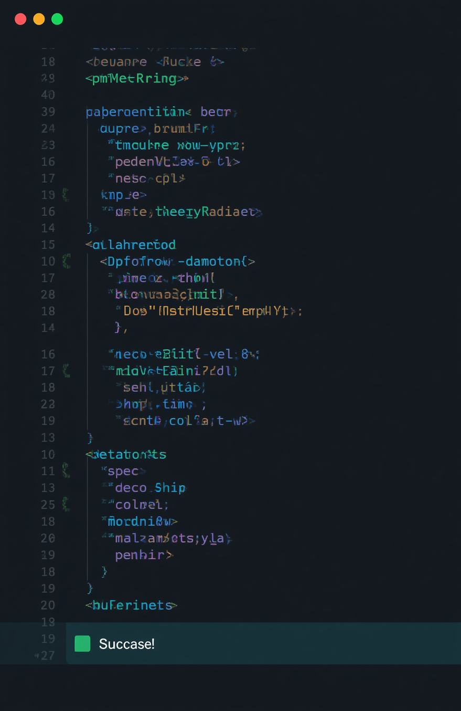
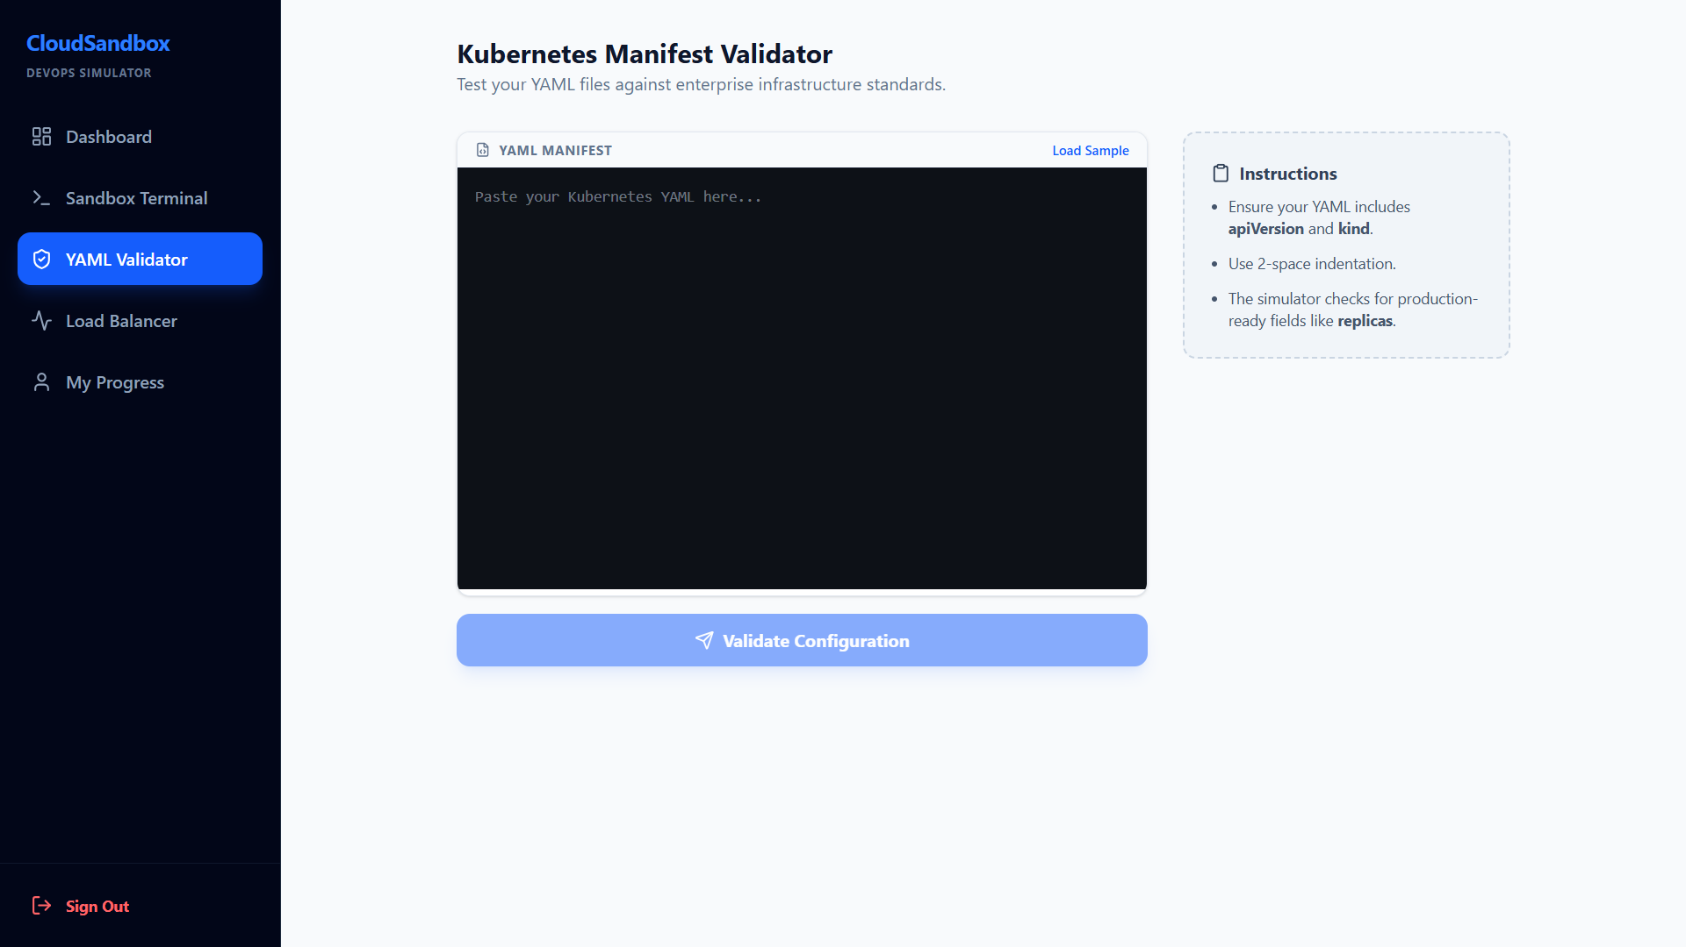

Kubernetes Manifest Validation
Write, Validate & Deploy YAML Manifests
Users write Kubernetes YAML manifests directly in the platform. Syntax checking and best-practice enforcement catch errors instantly. Validated manifests trigger simulated deployments, giving real Kubernetes workflow experience without a live cluster.

Slide 6


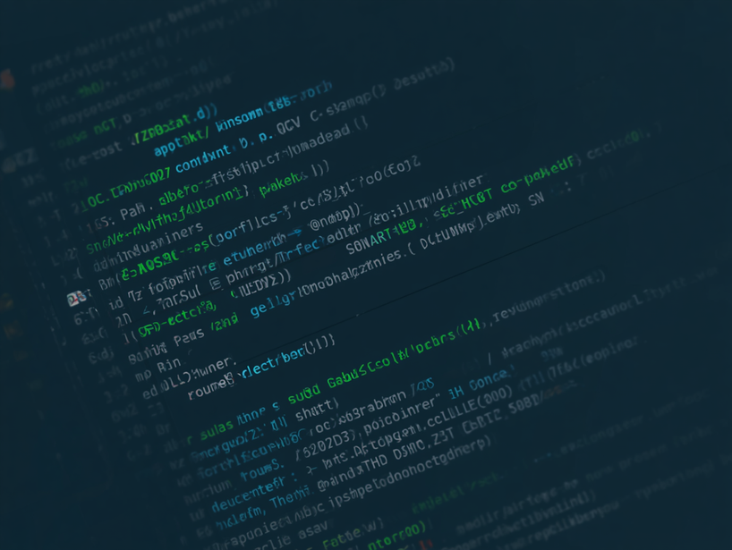
Load Balancer Simulation
Traffic Distribution
Round-robin traffic distribution routes requests evenly across running containers. Real-time logs capture every routing decision, providing transparent visibility into load balancing behavior and container health.

Slide 7
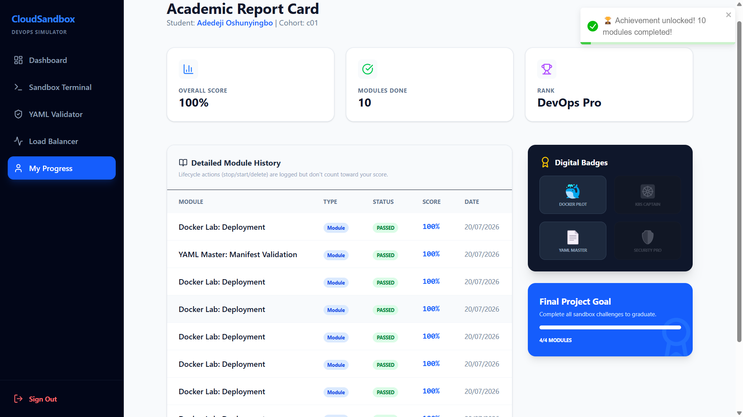
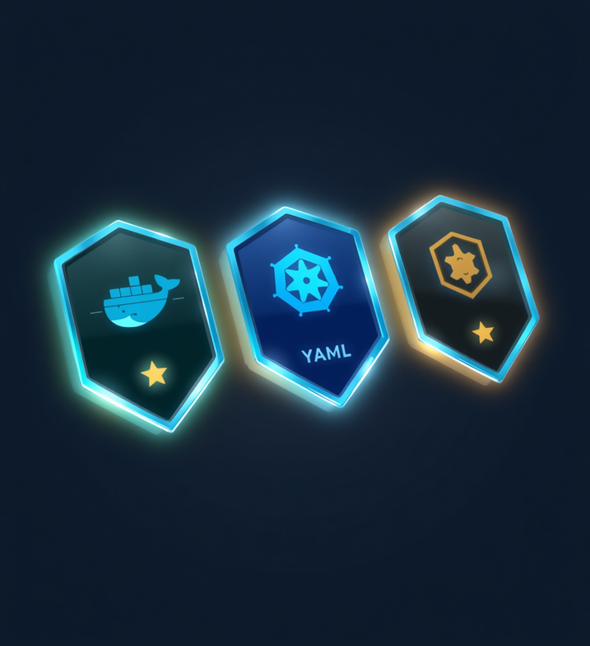
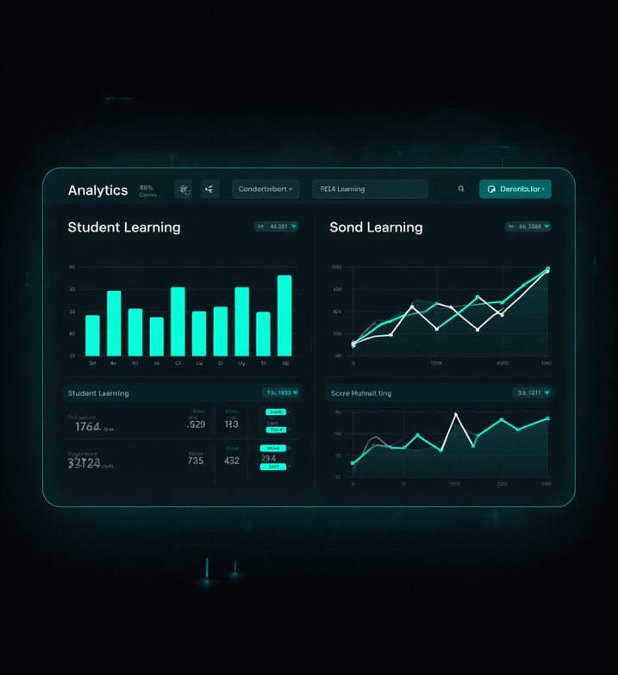
Progress Tracking & Gamification
Learn, Earn & Level Up
Academic-style report cards track module completion. Earn achievement badges: Docker Pilot, K8s Captain, and YAML Master. Full score history and progress analytics keep learners motivated and on track.

Slide 8

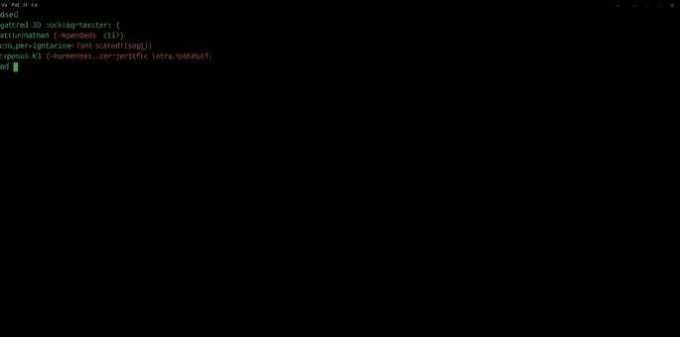

Feature 05 — User Interface & Interaction
Built with XTerm.js, the web terminal delivers a real CLI experience in the browser. Run Docker commands (run, stop, start, delete), apply Kubernetes manifests, and paste YAML directly for instant deployment simulation — no local setup required.
Interactive Terminal

Slide 9
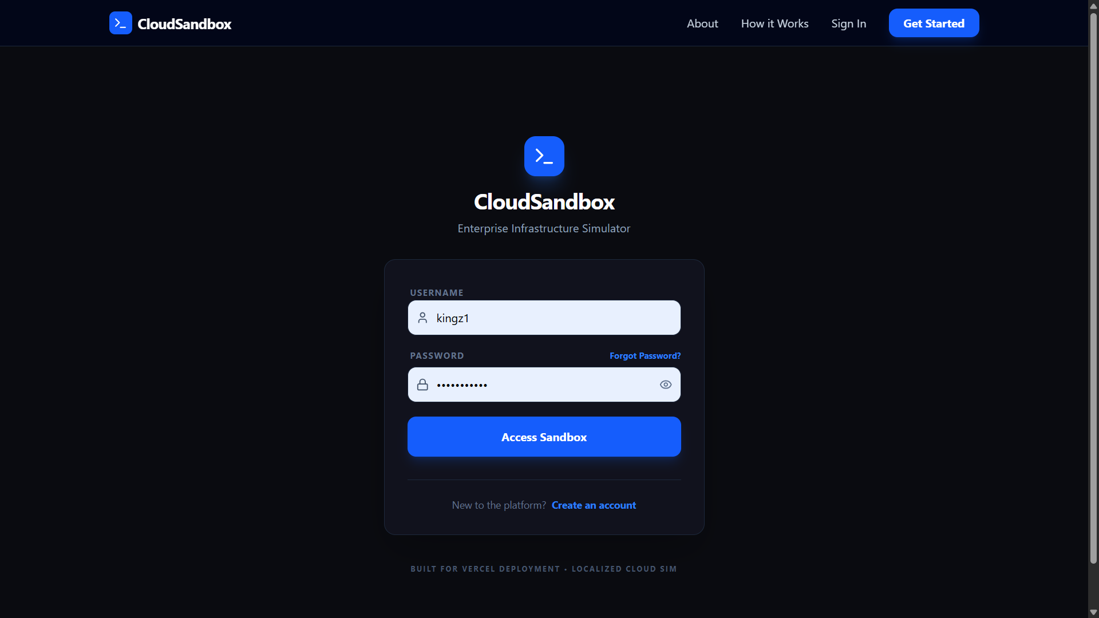
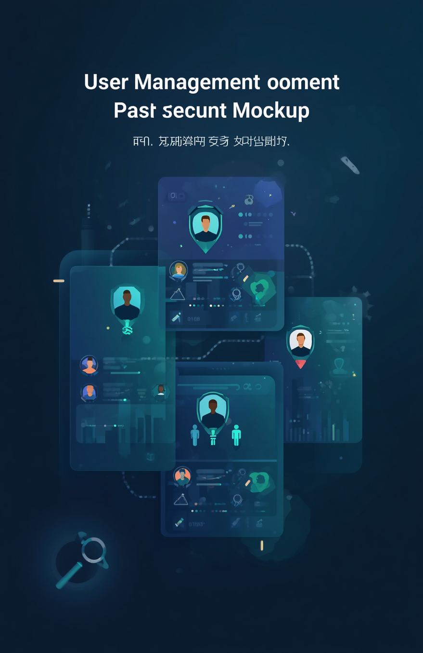
User Management
Security, Roles, and Access Control
JWT-based authentication ensures secure, stateless sessions across all microservices. Password resets are handled via Brevo SMTP email service. Role-based access control supports student, instructor, and admin roles. Cohort management enables educators to group and track learners efficiently.

Slide 10
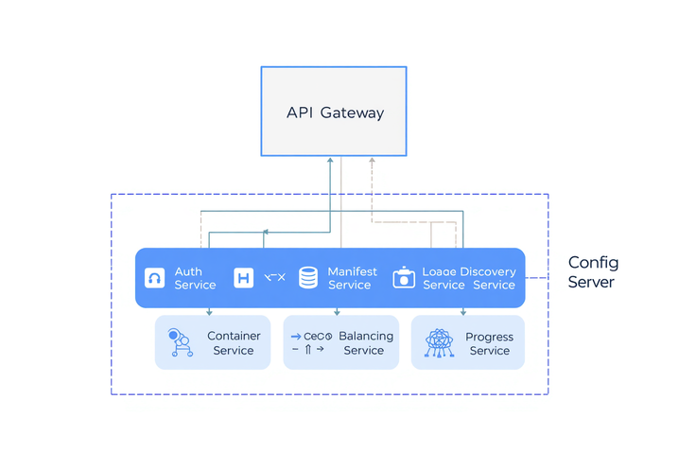

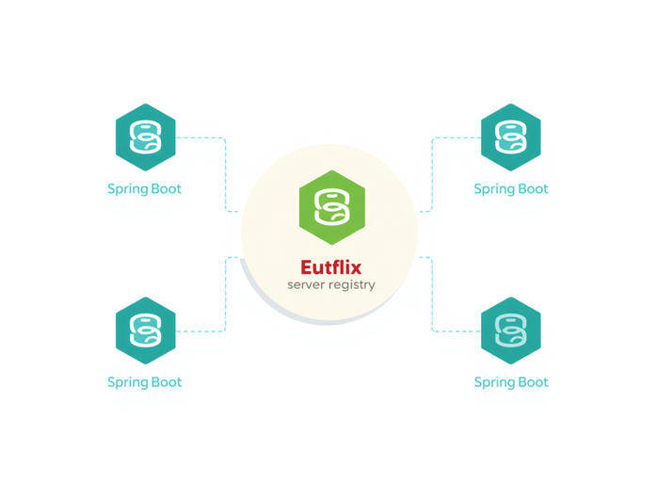
Microservices Backend Structure
API Gateway serves as the single entry point routing all client requests. Core services include Auth, Container, Manifest, Load Balancer, and Progress microservices — each built with Spring Boot. Netflix Eureka handles service discovery, while a centralized Config Server manages configuration across all services. PostgreSQL databases are isolated per service for clean separation of concerns.
Architecture
Overview

Slide 11


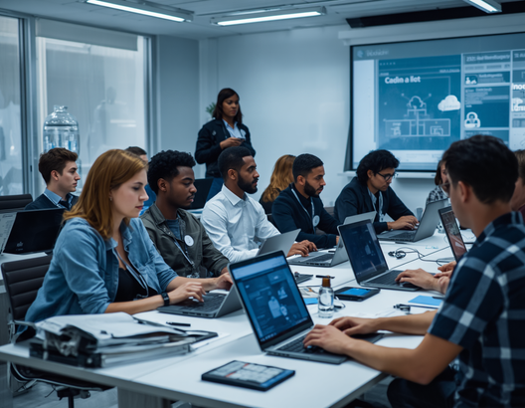
Target Audience
Who Benefits Most
• DevOps students learning Docker & Kubernetes hands-on
• Career changers building practical cloud-native skills
• Bootcamp participants practicing infrastructure as code
• Self-learners exploring containerization without cloud costs

Slide 12
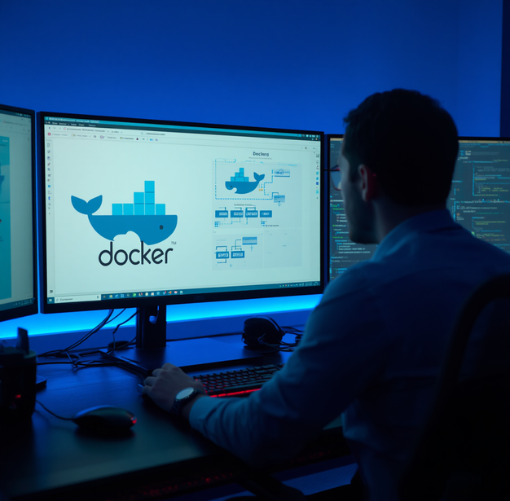
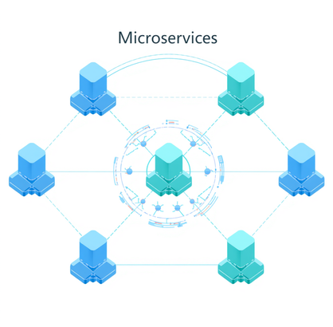


Learning Outcomes & Skills Gained
Educational
Value
• Docker fundamentals: image management & container lifecycle
• Kubernetes: pods, deployments & manifests
• Load balancing principles & traffic distribution
• Infrastructure as Code via YAML validation
• Cloud-native patterns: microservices, service discovery & API gateways

Slide 13



Platform Hosting & Infrastructure
Backend microservices deployed on Render.com for scalable cloud hosting. PostgreSQL databases provisioned and managed via Aiven cloud database platform. React frontend hosted on Vercel with CI/CD pipeline integration. Email notifications and password resets powered by Brevo SMTP service.
Deployment & Technology Stack

Slide 14



Thank You for Your Attention!
github.com/kingz1127/DevOps-CloudSandBox
Questions & Feedback Welcome
Oshunyingbo Adedeji | July 29 2026

